Slide 1
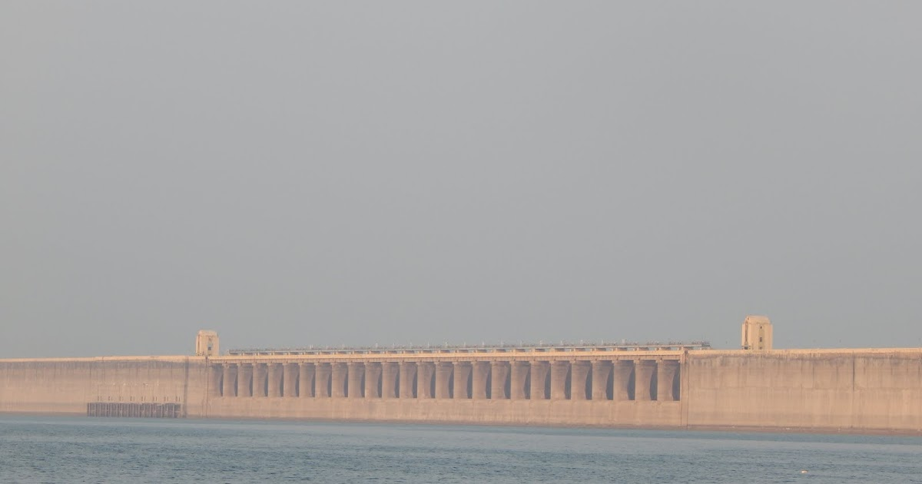

Welcome
This Photo by Unknown Author is licensed under CC BY-SA

Slide 2

Welcome
This Photo by Unknown Author is licensed under CC BY-SA

Slide 3

Welcome
This Photo by Unknown Author is licensed under CC BY-SA

Slide 4

Welcome
This Photo by Unknown Author is licensed under CC BY-SA

Slide 5


Agenda
Introduction
Insights
Dashboard
Suggestions
Queries

Slide 6
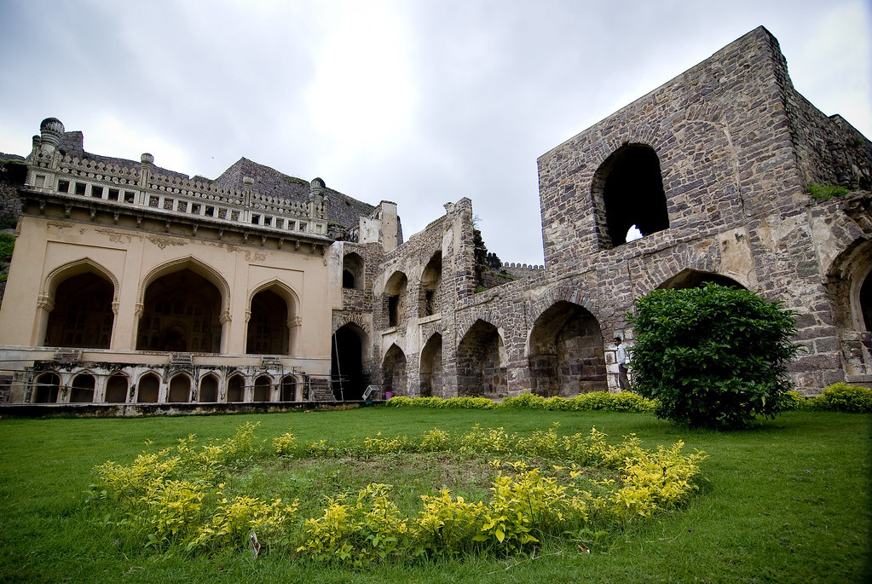
Telangana is located in the southern part
of INDIA and is renowned for its natural attractions,
temples, palaces, forts and other heritage sites
This Photo by Unknown Author is licensed under CC BY-SA-NC

Slide 7
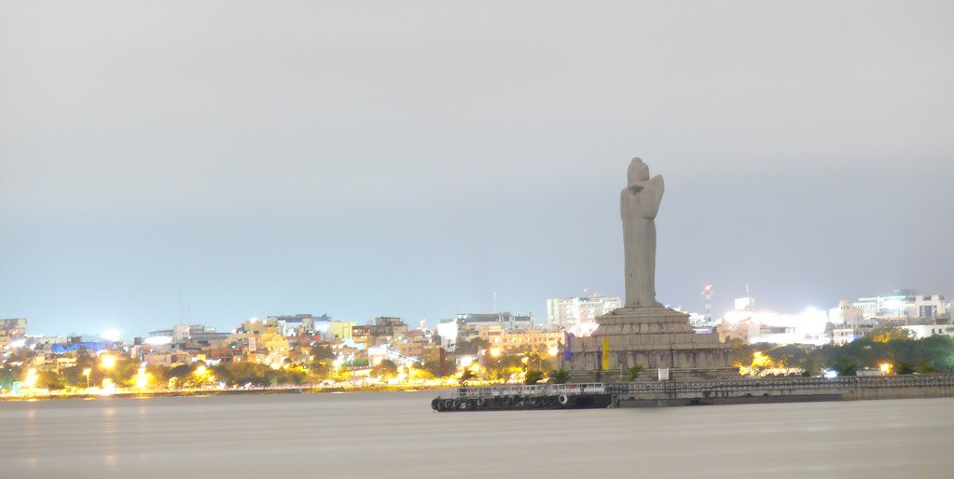
The rich cultural heritage of the Telangana
makes It one of the most visited tourist
destinations in South India

Slide 8

- Insights by HOTHURU ESWAR GOWD

Slide 9
WHY..?
This analysis will help to the
Tourism Department of Telangana
They can understand what kind
of things they should implement

Slide 10
WHAT..?
We are going to find insights
from the previous visitors data
Give some suggestions to
Telangana Tourism Department

Slide 11
Overview
We collected data from the official
Website of Telangana Govt
Find the insights from the data what we collected
Providing insights & suggestions to Govt

Slide 12
Insights

Slide 13
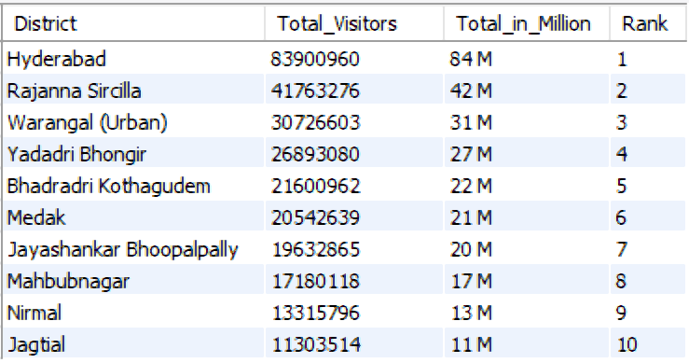
Question
List down the top 10 districts that have the highest number of domestic visitors overall (2016-2019)
Output
Insight
These are the top 10 districts that are doing well and HYDERABAD is
In the top 1 and it’s having 84m visitors from 2016 - 2019

Slide 14




Question
List down the top 10 districts that have the highest number of domestic visitors overall (2016-2019)
Output
Insight
These are the top 10 districts that are doing well and HYDERABAD is
In the top 1 and it’s having 84m visitors from 2016 - 2019

Slide 15
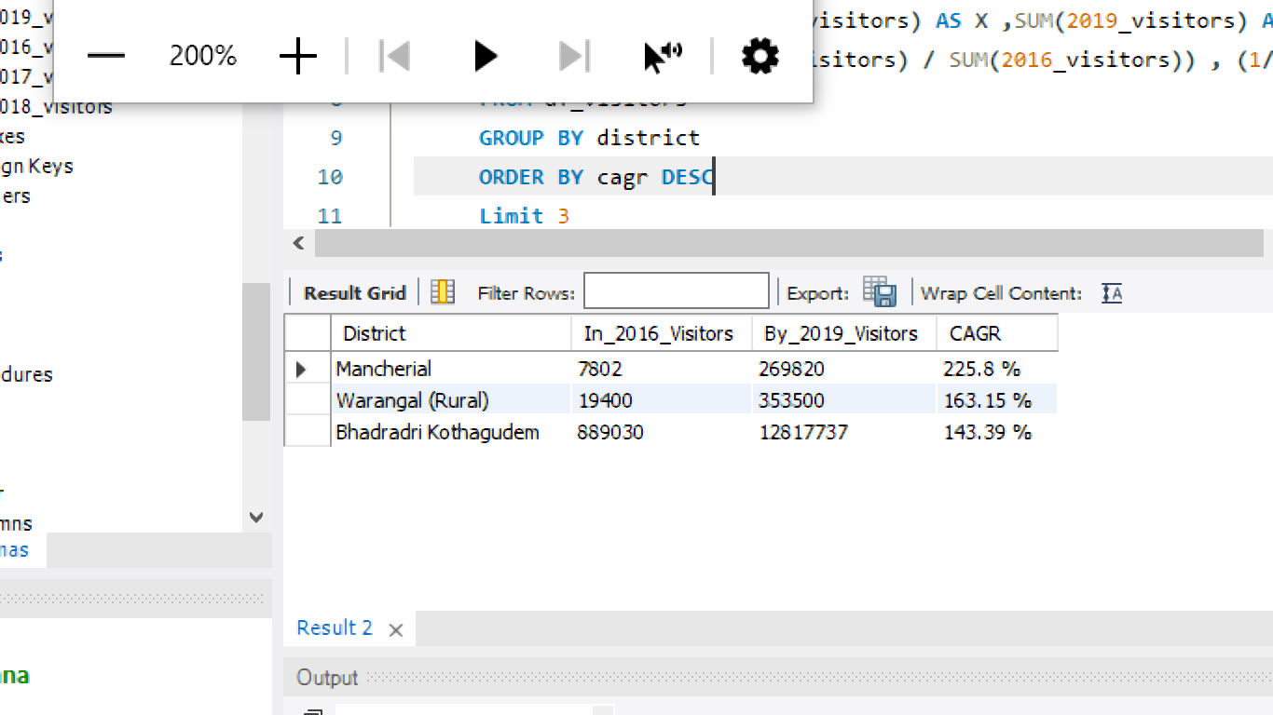
Question
List down the top 3 districts based on the compounded annual growth rate (CAGR)
of visitors between (2016-2019)
Output
Insight
These 3 districts are growing since 2016

Slide 16
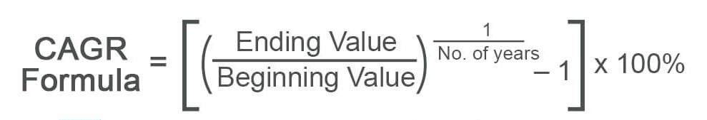
What is CAGR ?
CAGR is stands for
COMPOUND ANNUAL GROWTH RATE

Slide 17

Question
List down the top 3 districts based on the compounded annual growth rate (CAGR)
of visitors between (2016-2019)
Output
Insight
These 3 districts are growing since 2016

Slide 18
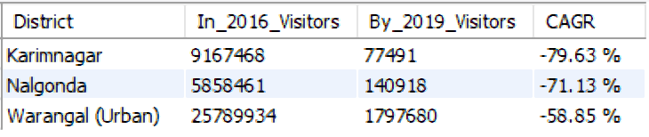
Question
List down the bottom 3 districts based on compounded annual growth rate (CAGR)
of visitors between (2016 - 2019)
Output
Insight
These 3 districts are not growing since 2016 ,
Govt should take care of these districts and try to implement
Something new to attract visitors

Slide 19
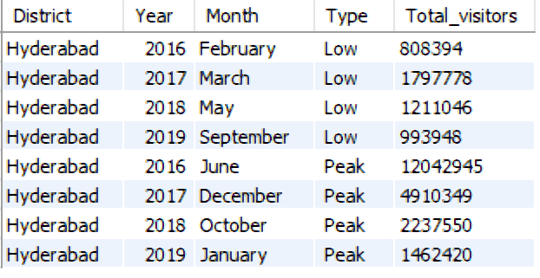

Question
what are the peak and low season months for HYDERABAD based on the data from
2016 - 2019 for HYDERABAD district only ( Year wise )
Output
LOW
PEAK
Insight
These are the Peak & Low months for HYDERABAD

Slide 20
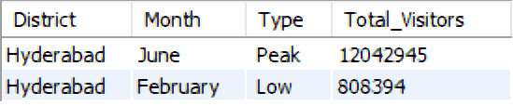

Question
what are the peak and low season months for HYDERABAD based on the data from
2016 - 2019 for HYDERABAD district only ( Total wise )
Output
Insight
June month is the peak month and February is the Low
Month for Hyderabad from 2016 - 2019

Slide 21
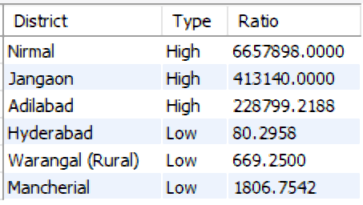
Question
show the top & bottom 3 districts with high domestic to foreign tourist ratio
Output
HIGH
LOW
Insight
In top 3 districts they are more domestic visitors as compared
To foreign visitors and you can see the HYD having almost equal
Number of domestic and foreign visitors

Slide 22
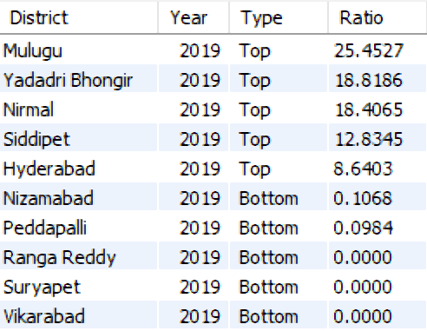
Question
List the top & bottom 5 districts based on ‘population to tourist footfall ratio*’ ratio in 2019
Output
TOP
BOTTOM
Insight
These top districts are high in ratio so government can plan
to accommodate more tourists in that districts

Slide 23
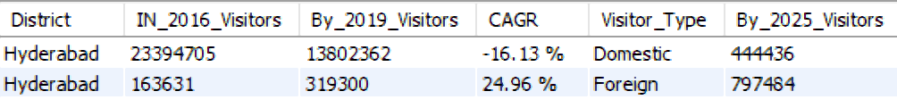
Question
What will be the projected number of domestic and foreign tourists in Hyderabad
in 2025 based on the growth rate from previous years
Output
[ Formula : ( (CAGR * Years) * CV ) / 100 + CV ]
Insight
Domestic visitors will decrease -16.13% year by year upto 2025
And Foreign visitors will increase by 24.96% in 2025

Slide 24
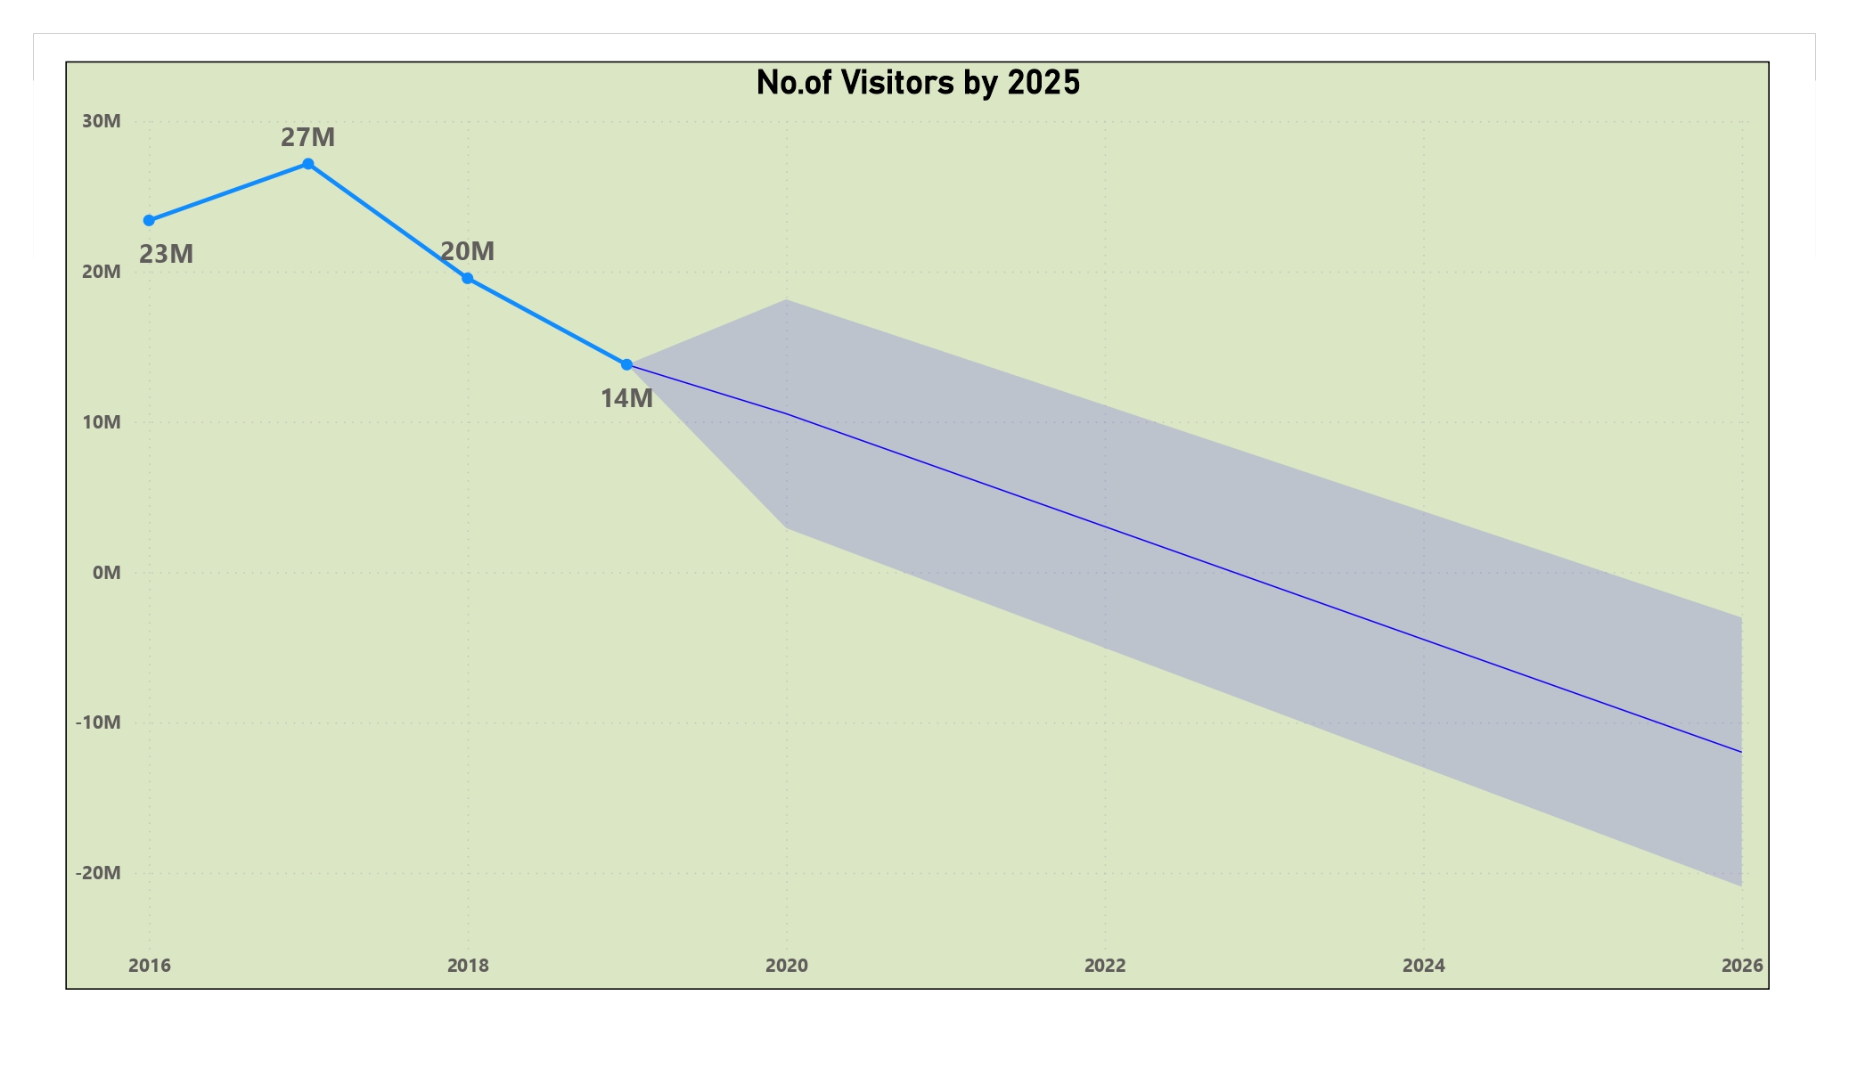
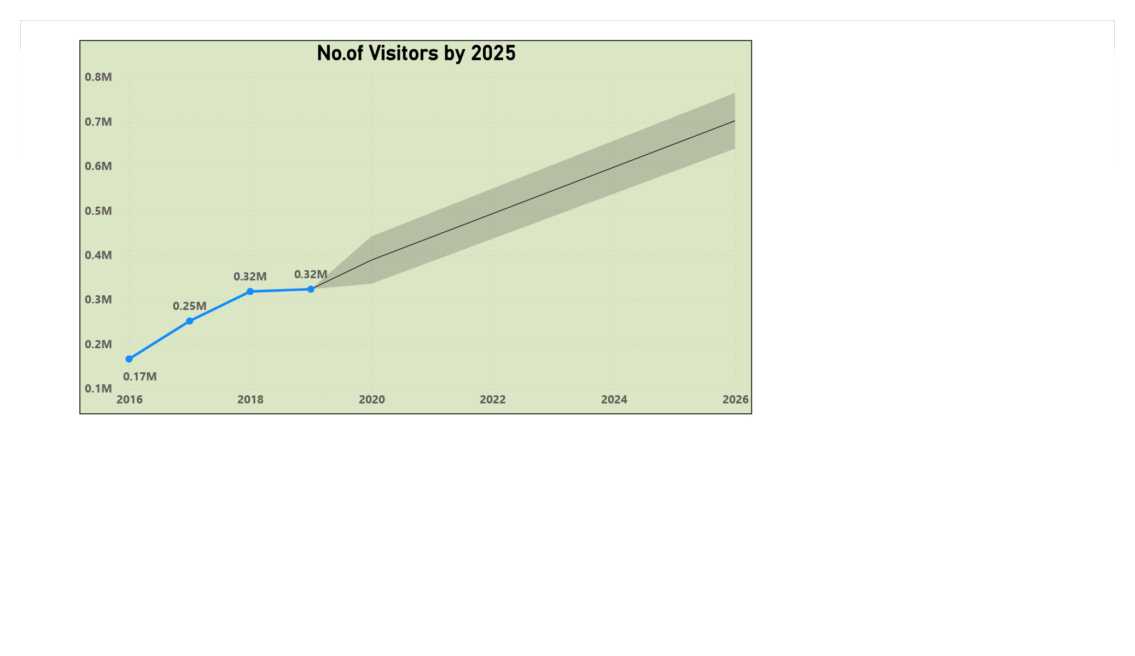


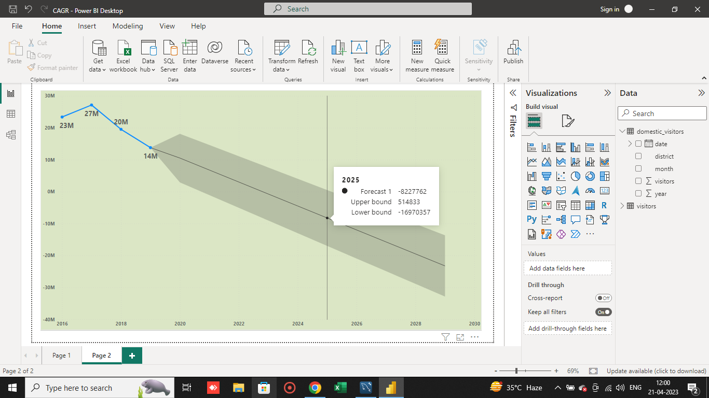
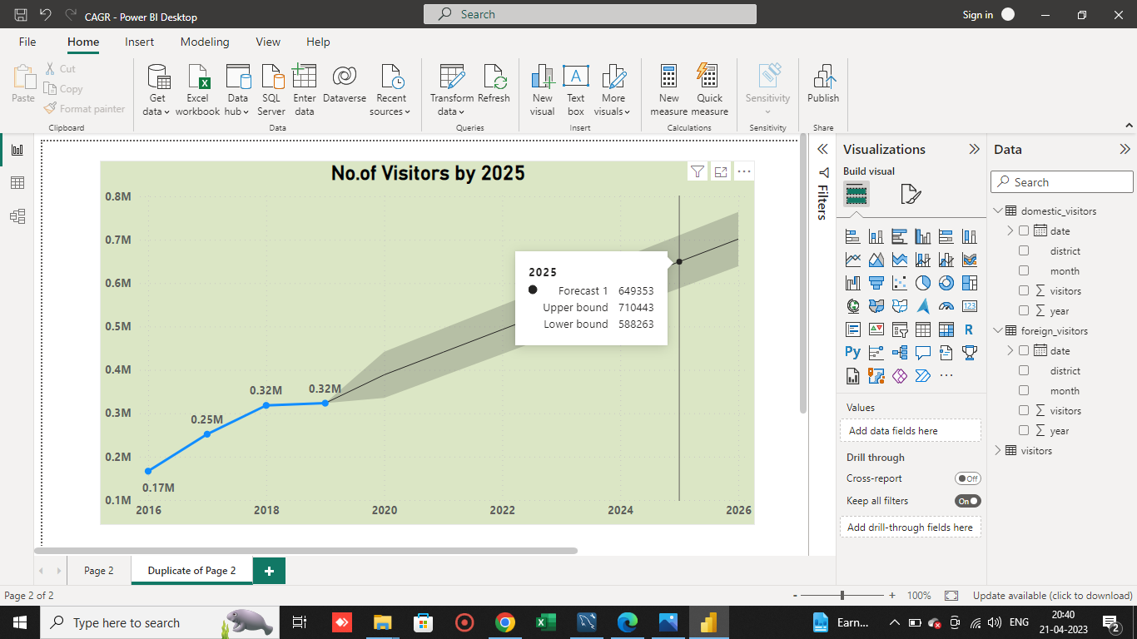
Question
What will be the projected number of domestic and foreign tourists in Hyderabad
in 2025 based on the growth rate from previous years
Domestic
Foreign

Slide 25
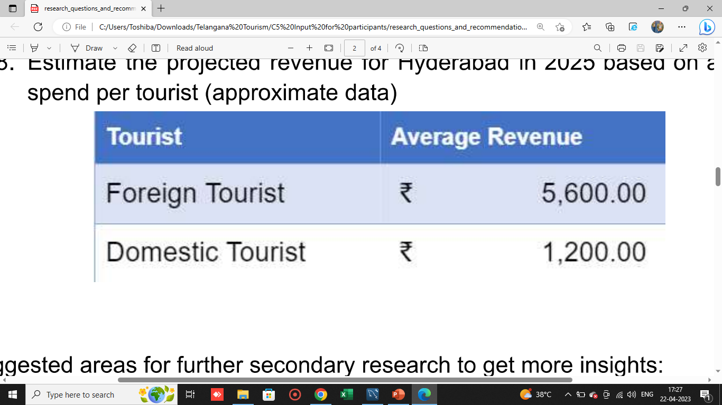

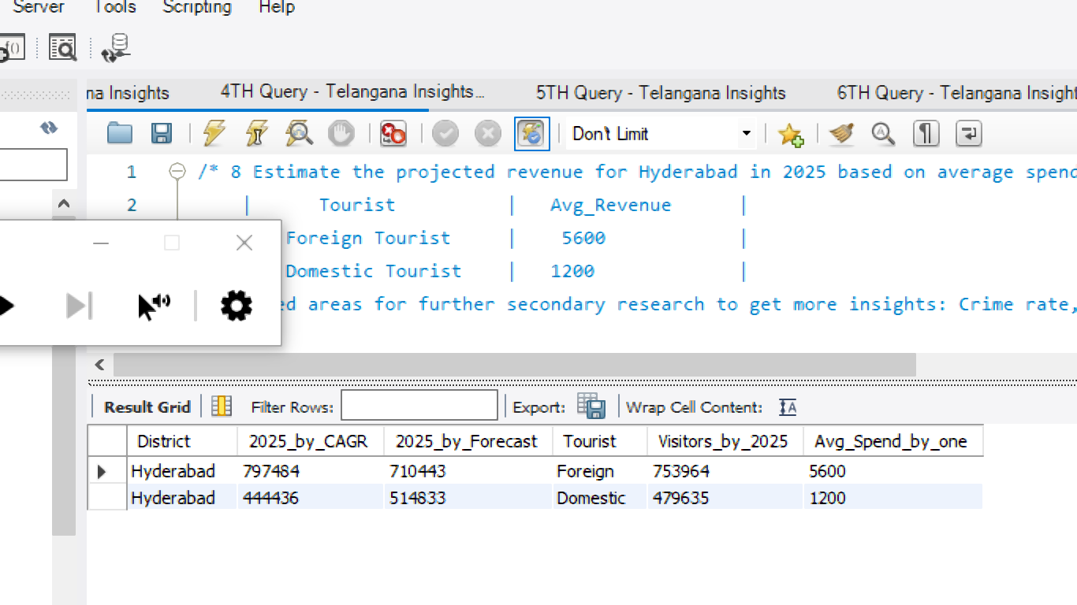
Question
Estimate the projected revenue for Hyderabad in 2025 based on average spend
per tourist (approximate data)
Avg of CAGR & Forecast

Slide 26
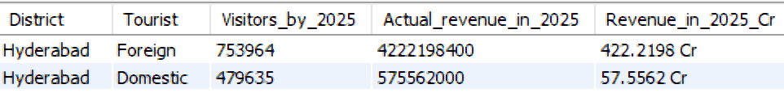
Question
Estimate the projected revenue for Hyderabad in 2025 based on average spend
per tourist (approximate data)
Output
Total = 479.7 Cr
Insight
Total revenue of HYDERABAD by 2025 is 479.776 Cr
as compared with the total visitors by 2025

Slide 27
Suggestions

Slide 28
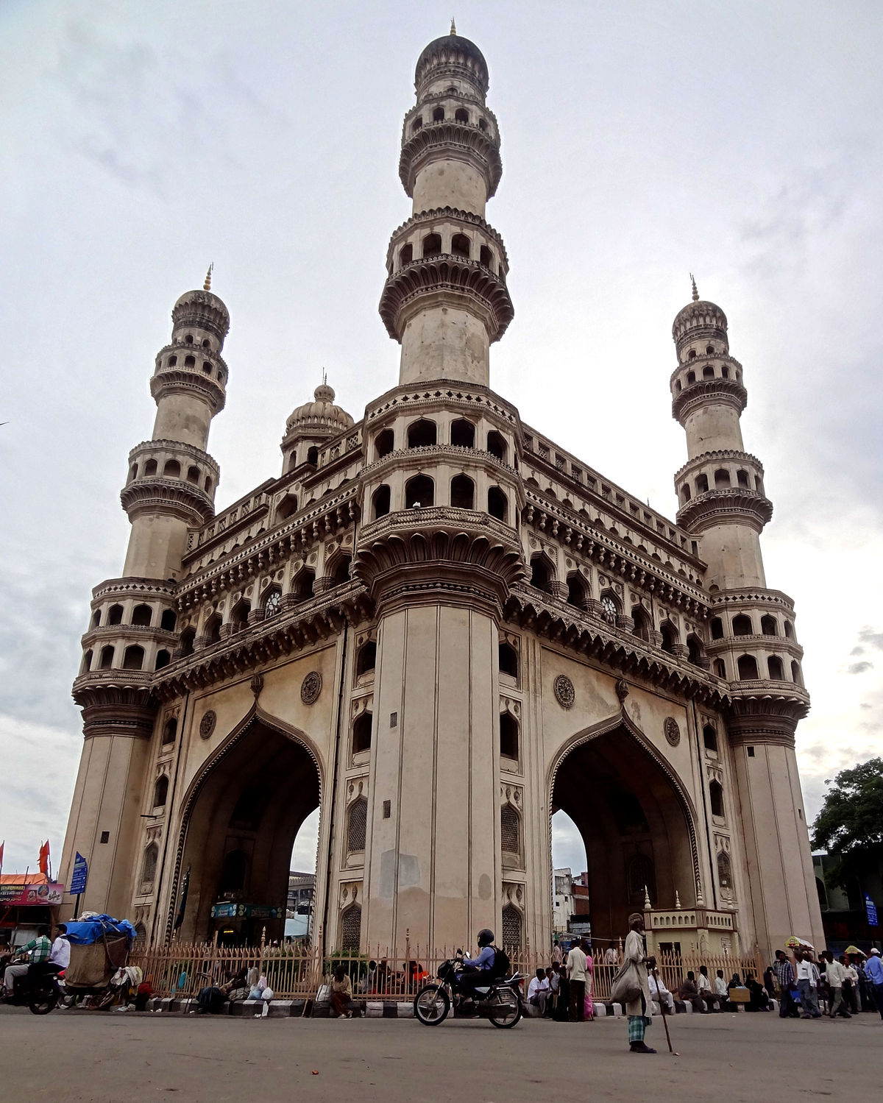
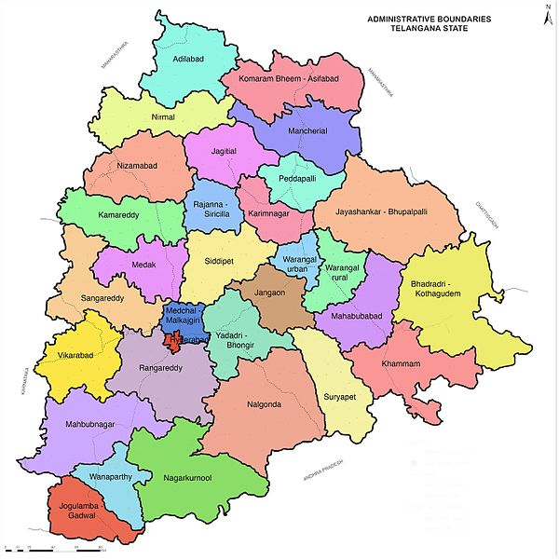
High Potential District for Tourism Growth
This Photo by Unknown Author is licensed under CC BY-SA
This Photo by Unknown Author is licensed under CC BY-SA
This Photo by Unknown Author is licensed under CC BY-SA
This Photo by Unknown Author is licensed under CC BY-SA

Slide 29

High Potential District for Tourism Growth
Mancherial & Warangal (Rural) these two districts have high potential
for tourism growth, because these two districts are attracting more tourists
year by year.
Manchirial is growing 225.8% every year and
Warangal (R) is growing with 163.15% every year

Slide 30
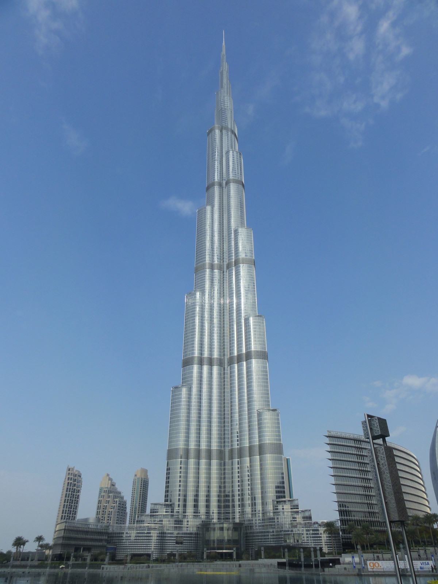
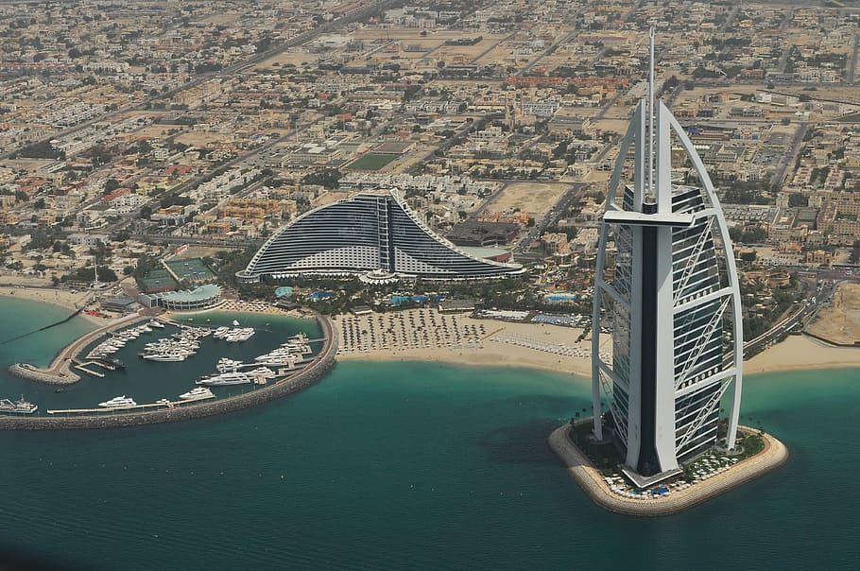
Can Hyderabad emulate the Dubai model?

Slide 31
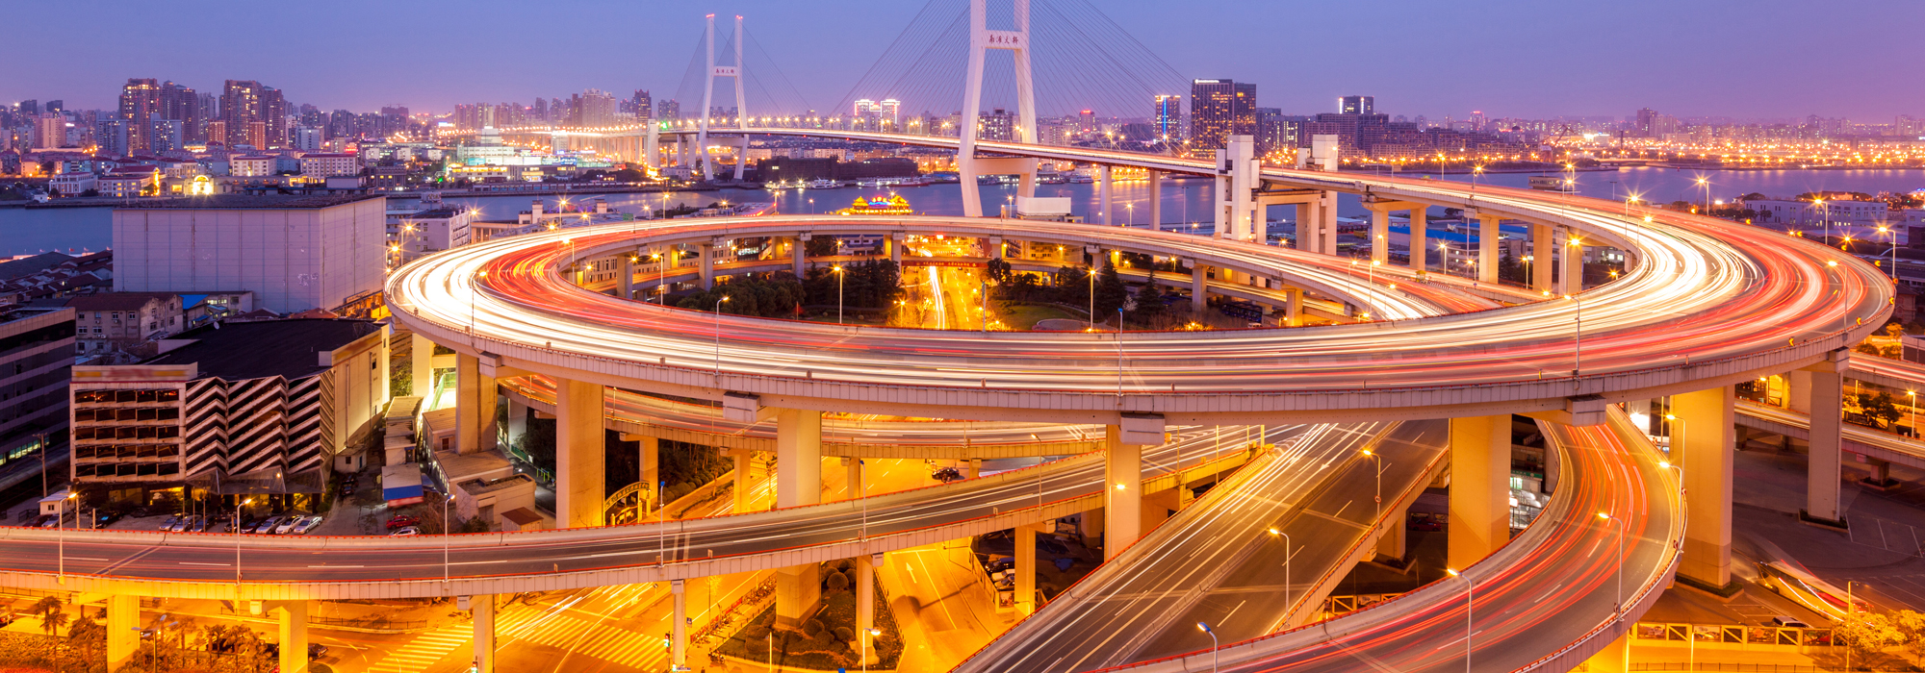
Can Hyderabad emulate the Dubai model?
YESS…HYD can but
It is not easy to attract that much of tourists in current situations
But there is a possibility when we do these things
Build high class Infrastructure
Implement new things like which is not exist and it should be interesting
Invest on Technology, now a days it is very boom
Beautiful Monuments or anything unique
Why NOT … HYD

Slide 32
Queries

Slide 33
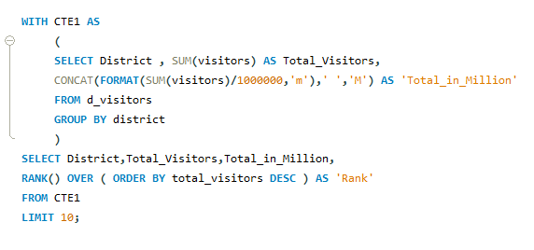
List down the top 10 districts that have the highest number of domestic visitors overall (2016-2019)

Slide 34
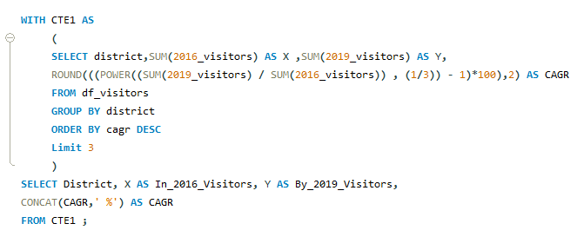
List down the top 3 districts based on the compounded annual growth rate (CAGR) of visitors
between (2016-2019)

Slide 35
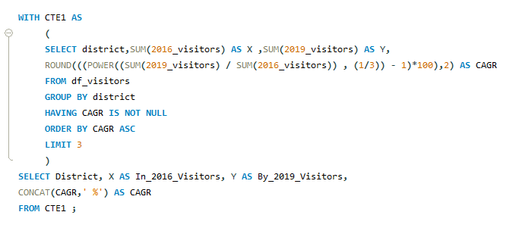
List down the bottom 3 districts based on compounded annual growth rate (CAGR) of visitors
between (2016 - 2019)

Slide 36
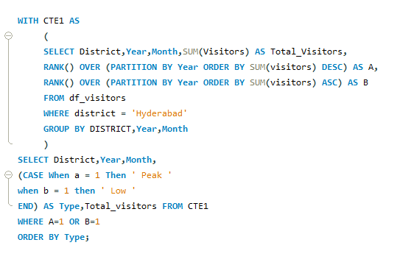
what are the peak and low season months for HYDERABAD based on the data from 2016 - 2019
for HYDERABAD district only ( Year wise )

Slide 37
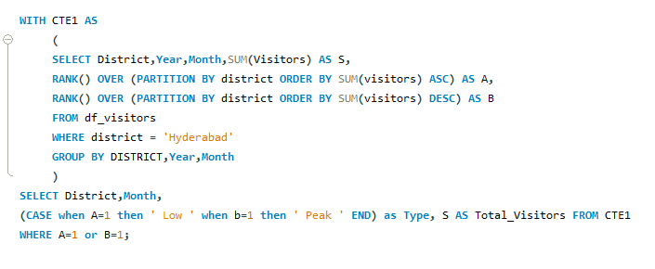
what are the peak and low season months for HYDERABAD based on the data from 2016 - 2019
for HYDERABAD district only ( Total wise )

Slide 38
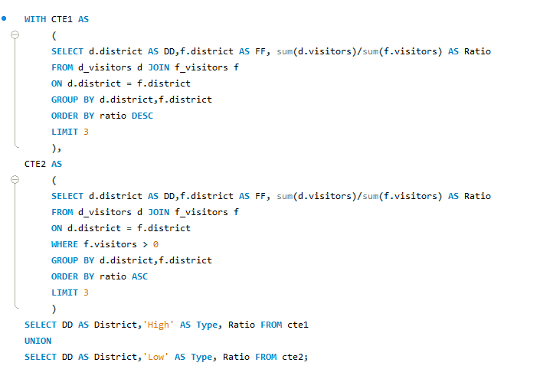
show the top & bottom 3 districts with high domestic to foreign tourist ratio

Slide 39
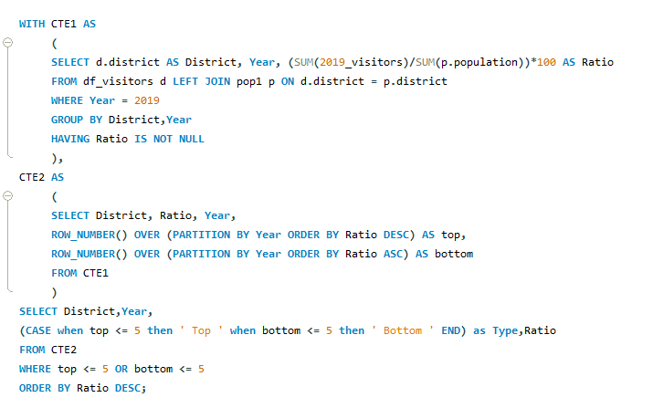
List the top & bottom 5 districts based on ‘population to tourist footfall ratio*’ ratio in 2019

Slide 40
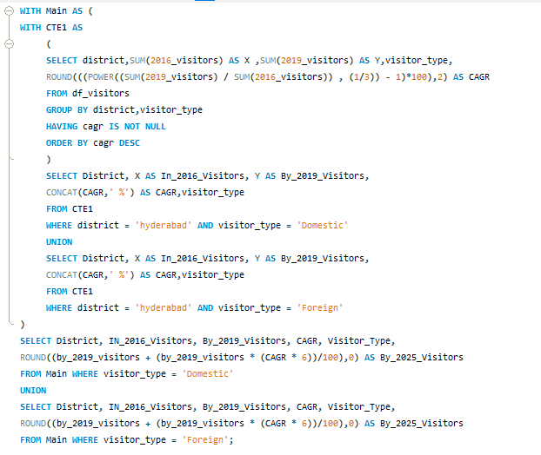
What will be the projected number of domestic and foreign tourists in Hyderabad in 2025 based
on the growth rate from previous years

Slide 41
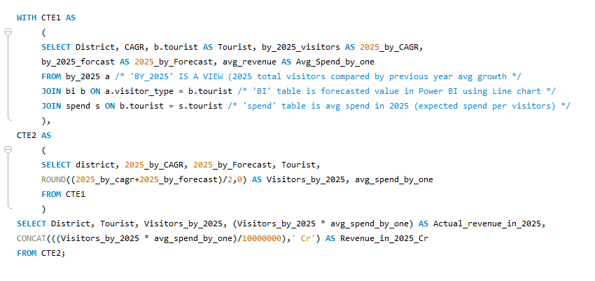
Estimate the projected revenue for Hyderabad in 2025 based on average spend per tourist

Slide 42


Slide 43


Slide 45
Thank You

